Slide 1
STUDENT DATABASE MANAGEMENT SYSTEM
MADE BY:-
HEEMAJ YADAV:-PES2UG21CS198
ISHA V RAO:-PES2UG21CS205

Slide 2
INTRODUCTION
Welcome to the Student Database Management System powered by Streamlit and Python. This comprehensive system is designed to efficiently manage various aspects of student information, attendance tracking, performance reviews, departmental details, leave records, class teacher assignments, and document management.
The Student Database Management System using Streamlit and Python provides a comprehensive solution for educational institutions to streamline administrative tasks, enhance communication, and maintain accurate records. Whether you're an educator, administrator, or student, this system is designed to meet the diverse needs of academic management. Dive into the functionalities and discover a powerful tool to transform the way to manage student information.

Slide 3
In educational institutions, managing diverse aspects of student data and administrative tasks can be challenging and time-consuming. This complexity arises from the need to efficiently handle information related to students, attendance, performance reviews, departments, leave records, class teacher assignments, and documents. Traditional methods of record-keeping often result in inefficiencies, inaccuracies, and difficulties in accessing timely information. To address these challenges, the Student Database Management System (DBMS) using Streamlit and Python is proposed.

Slide 4
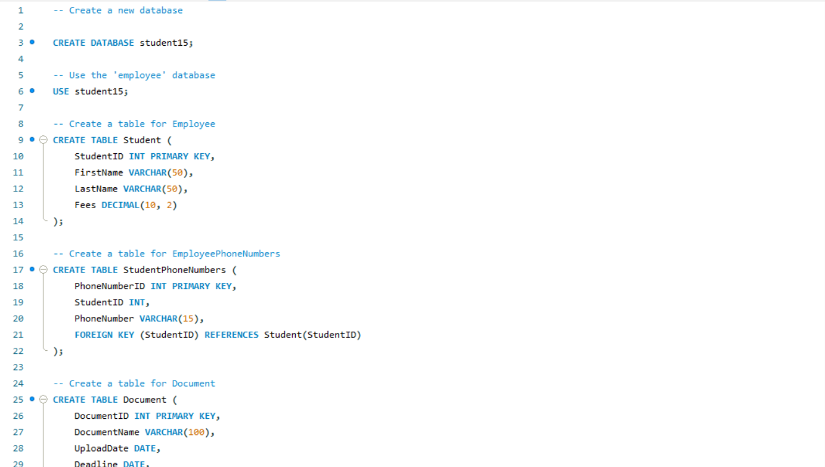
DDL STATEMENTS

Slide 5
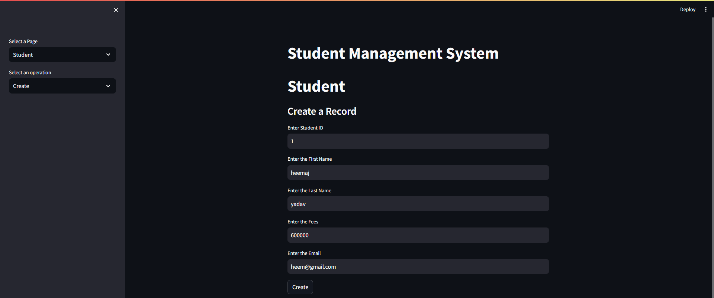
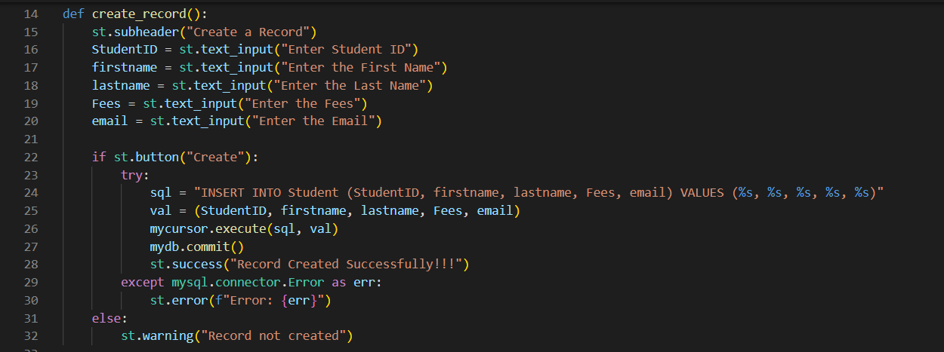
DML STATEMENTS

Slide 6
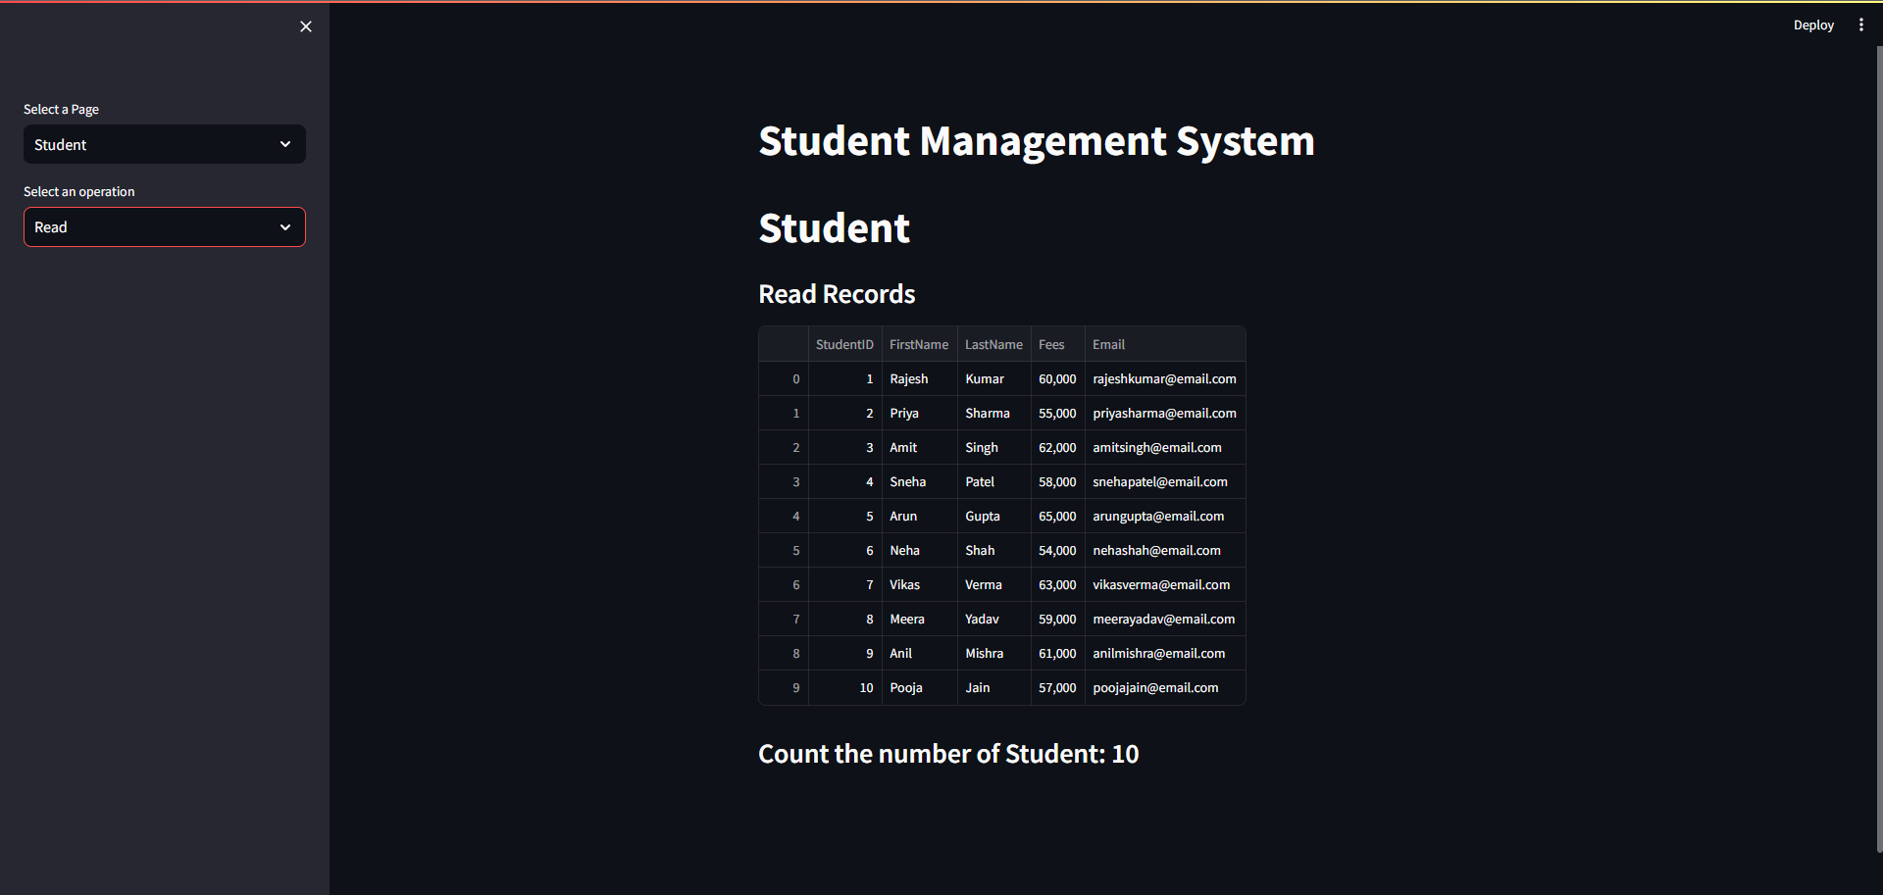
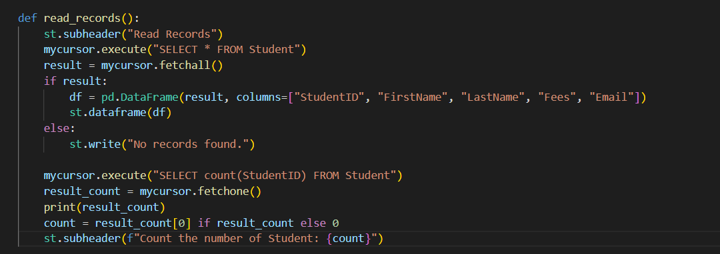
QUERIES
SIMPLE QUERY WITH GROUP BY, AGRREGATE

Slide 7
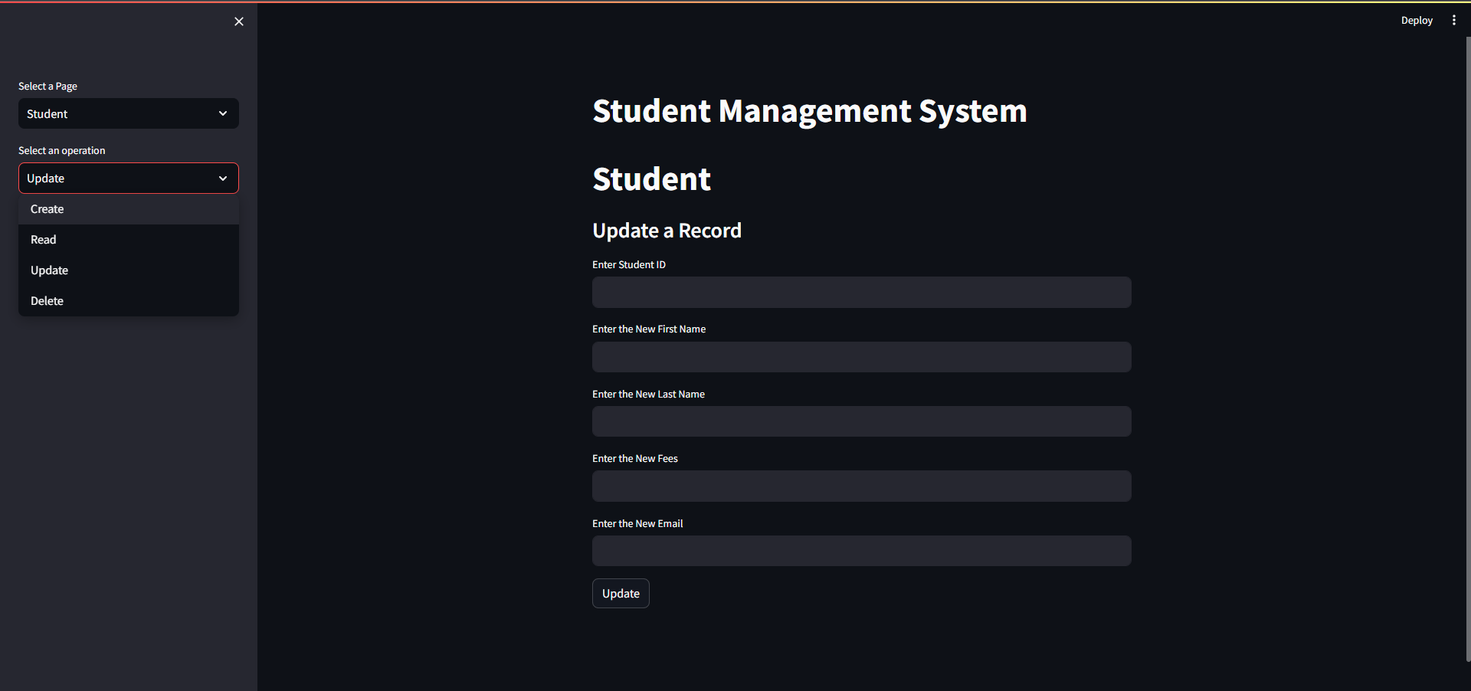
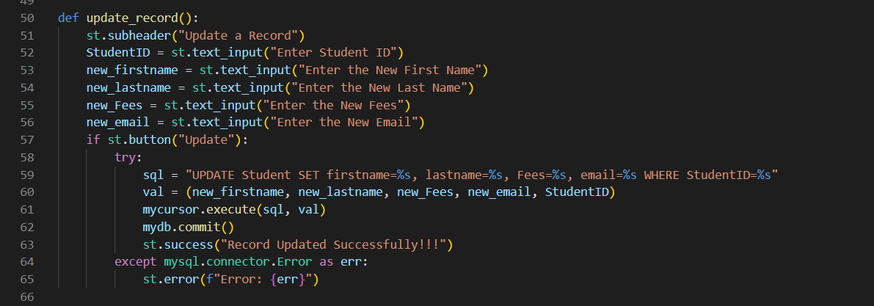
UPDATE OPERATION

Slide 8
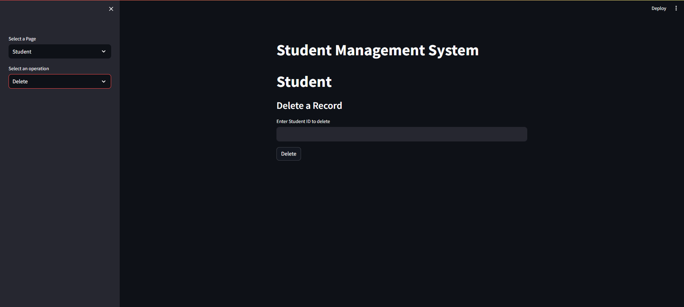
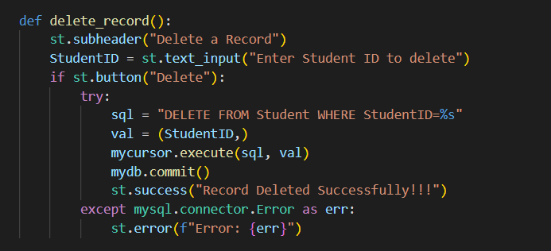
DELETE OPERATION

Slide 9
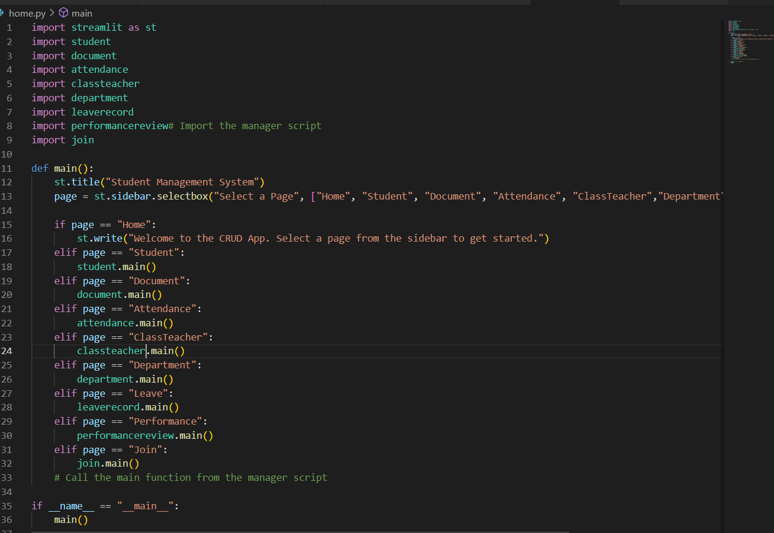
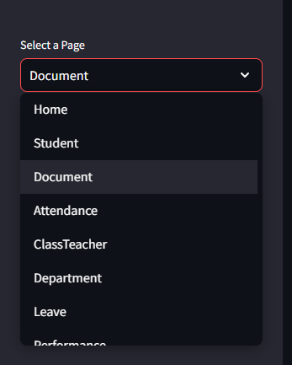
Connecting other .py files

Slide 10
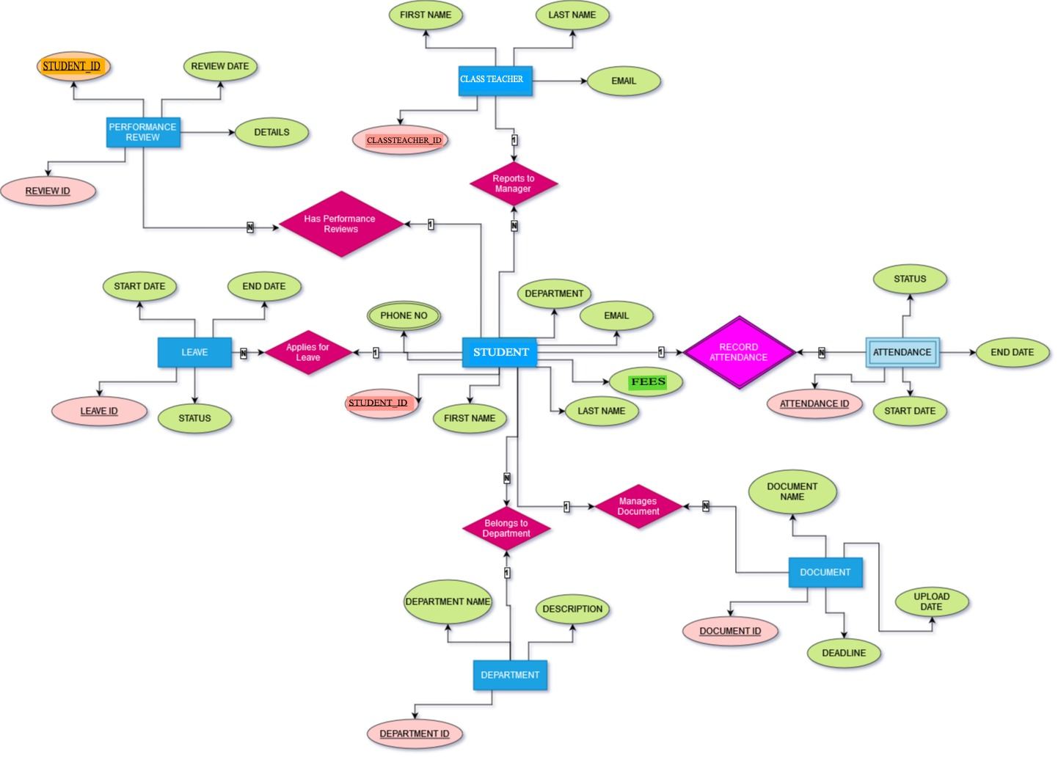
ER MODEL

Slide 11
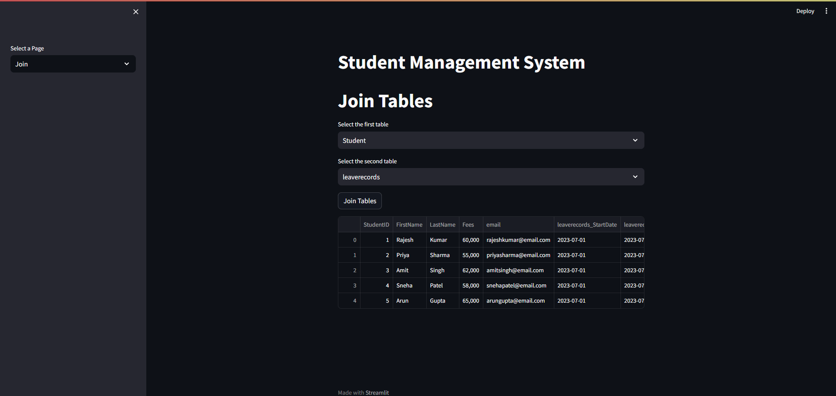
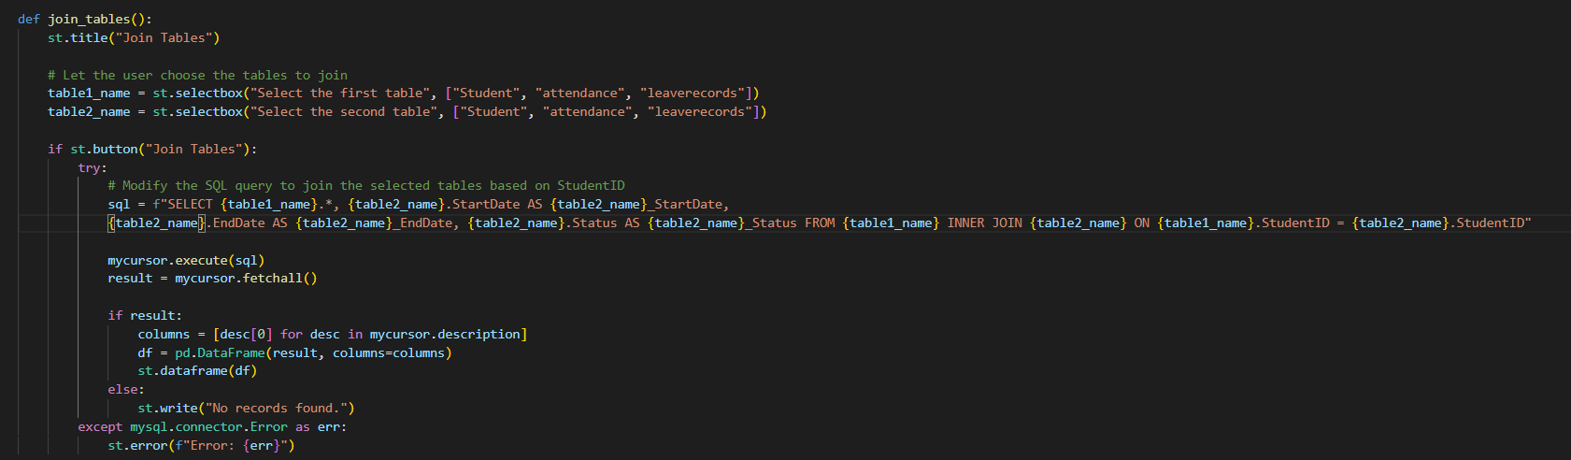
Retrieving the information of the student with respect to the other table
JOIN QUERY

Slide 12
THANK U

